Slide 1
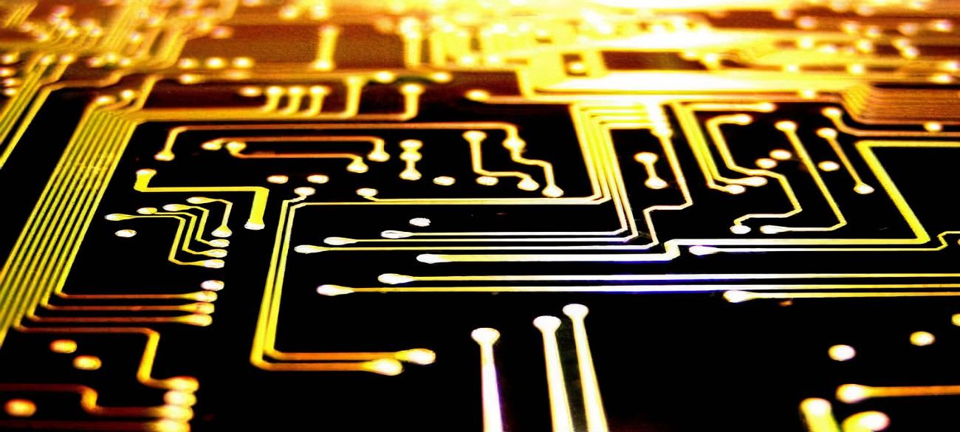
Digital logic gates
4bit even parity cheacker

Slide 2

What is even parity checker?
A circuit that checks for even parity in a 4-bit binary number. It works by counting the number of 1s in the 4-bit binary number and then checking if the number is even or odd.
If the number of 1s is even, the output of the circuit is 0.
If the number of 1s is odd, the output of the circuit is 1.
What is Parity Bit?
The parity generating technique is one of the most widely used error detection techniques for the data transmission. In digital systems, when binary data is transmitted and processed, data may be subjected to noise so that such noise can alter 0s (of data bits) to 1s and 1s to 0s.

Slide 3
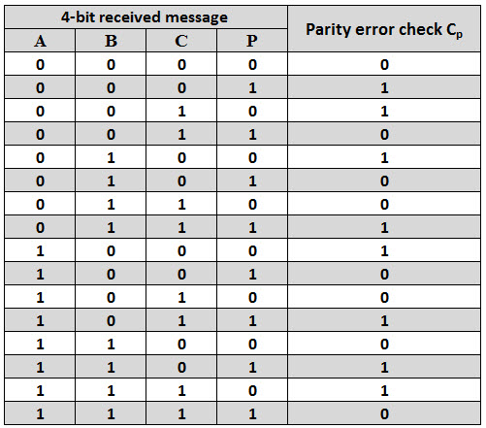
Truth Table

Slide 4
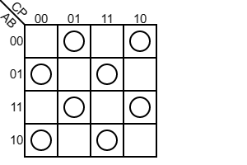
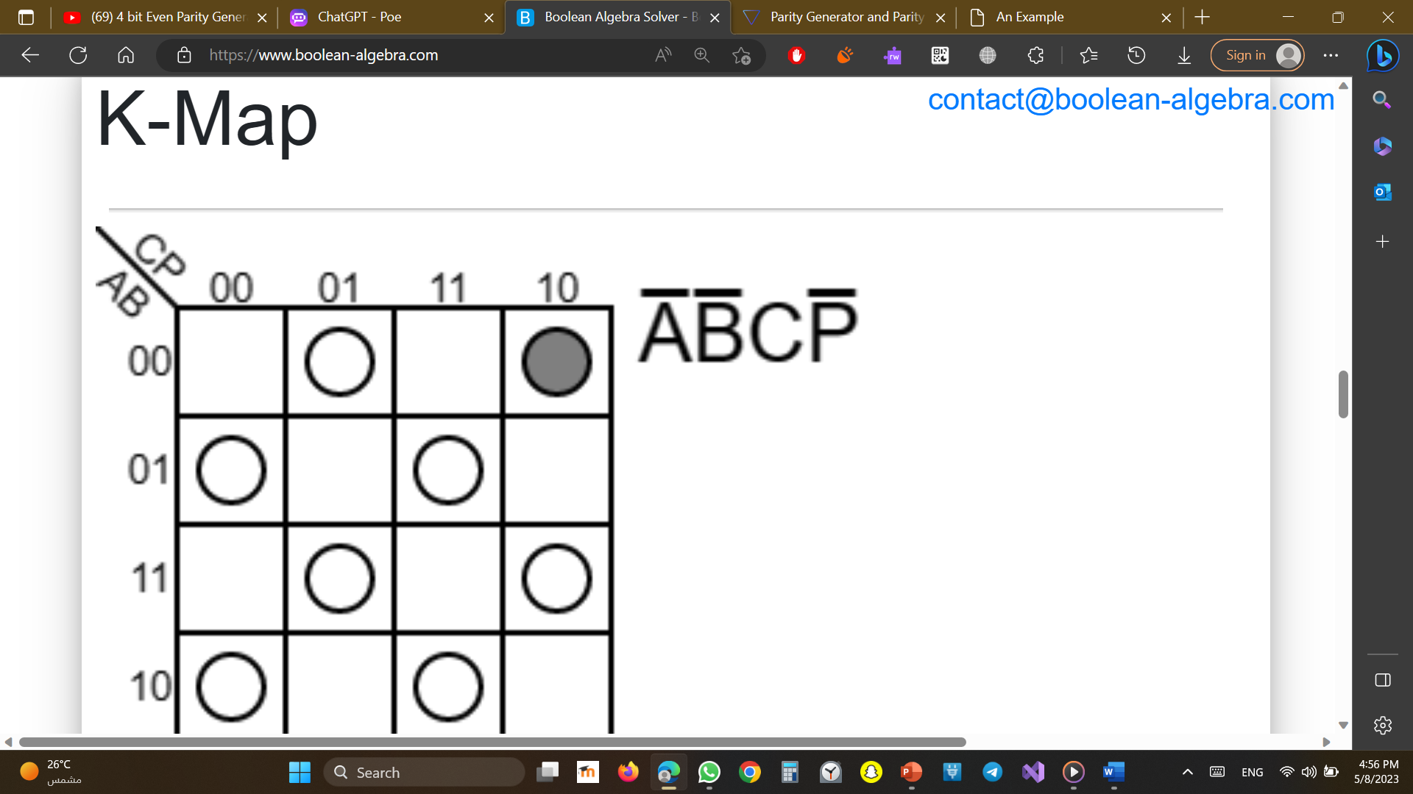
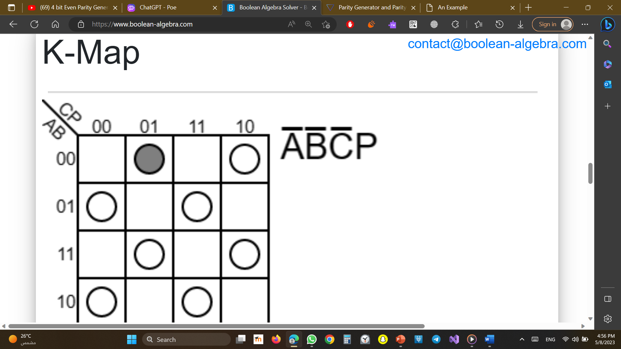
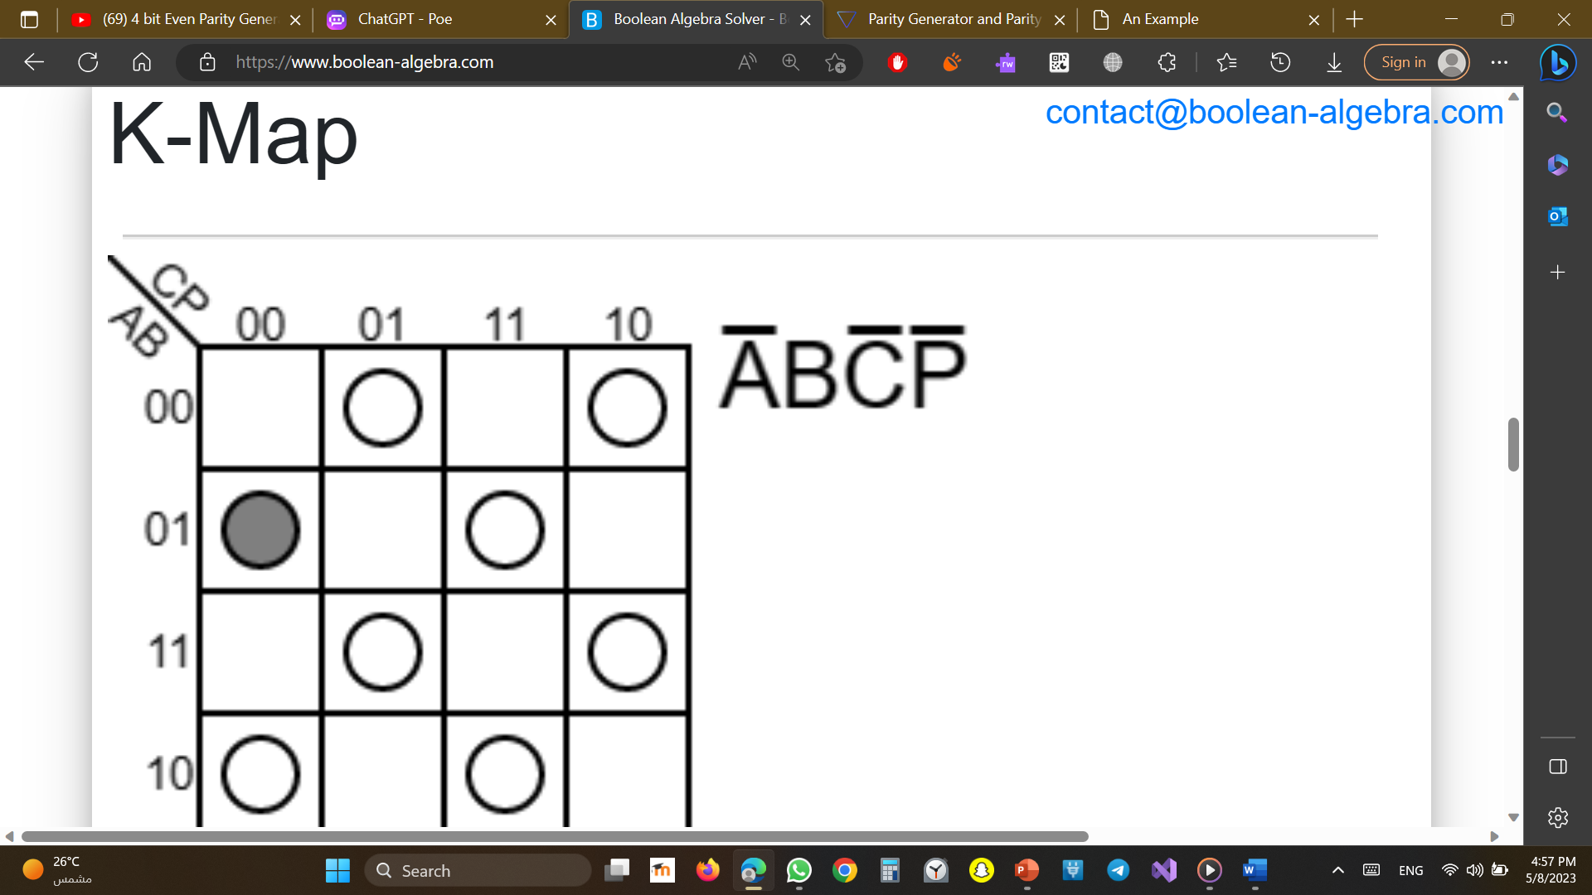
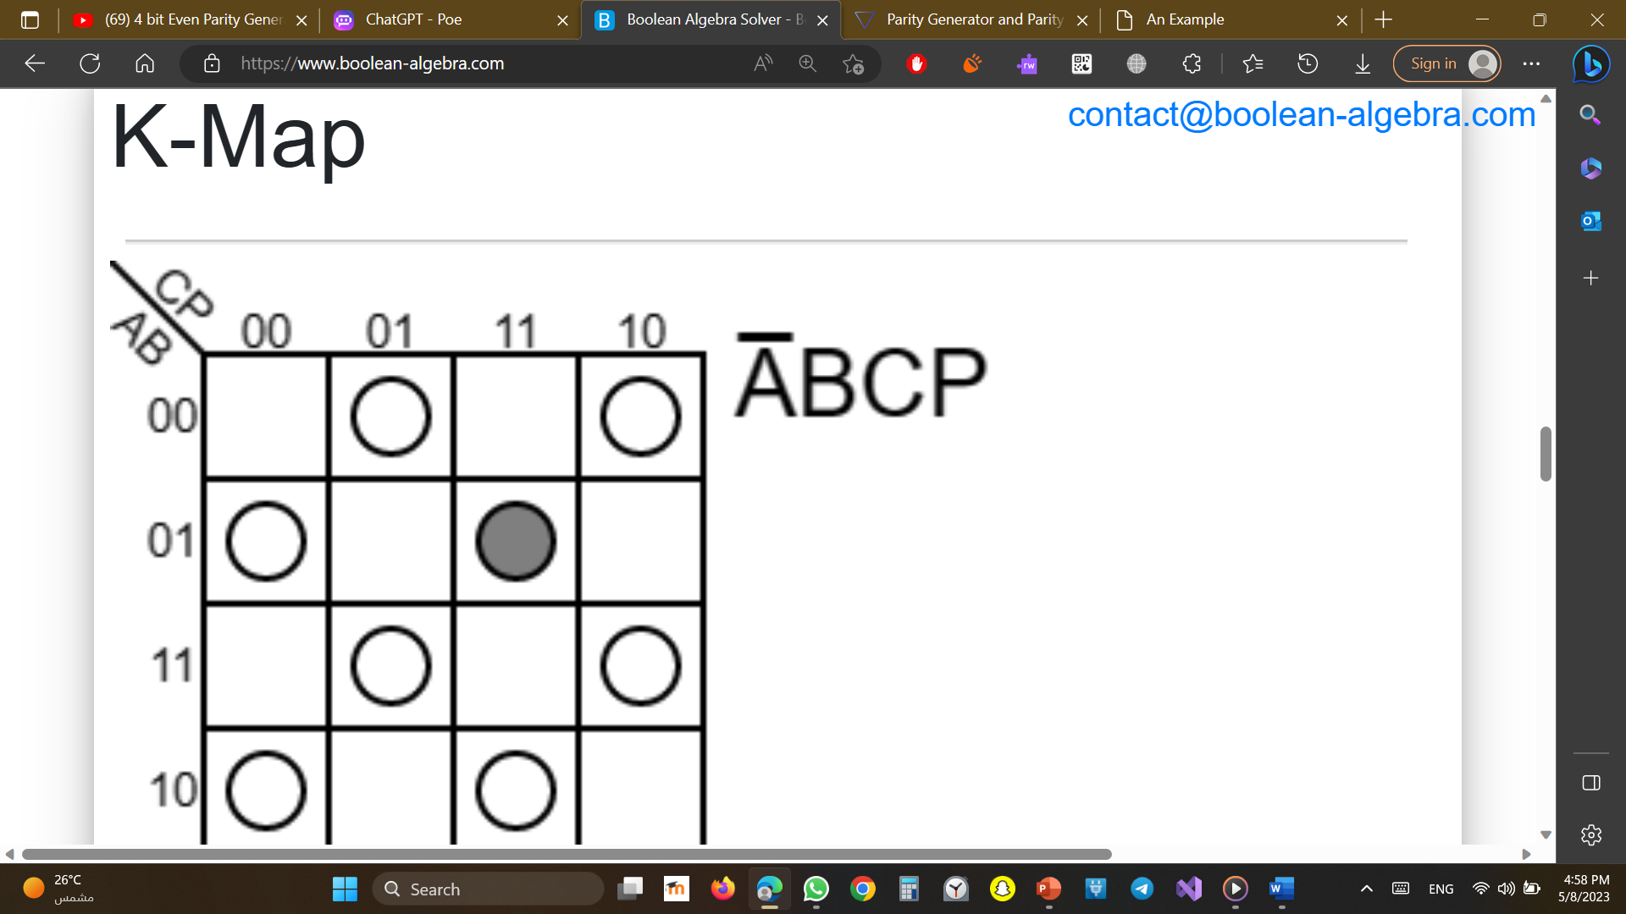
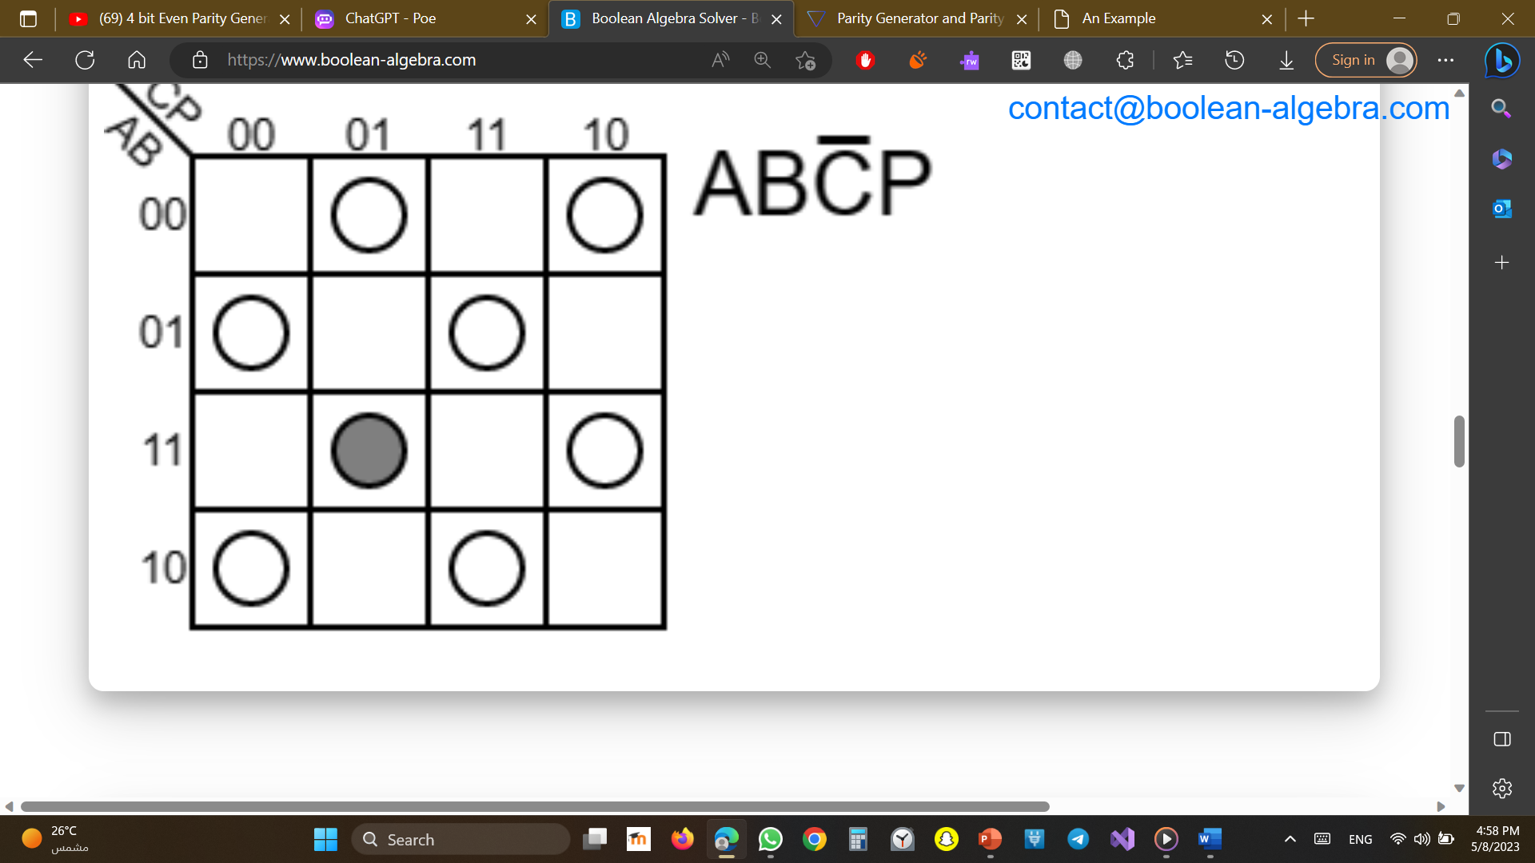
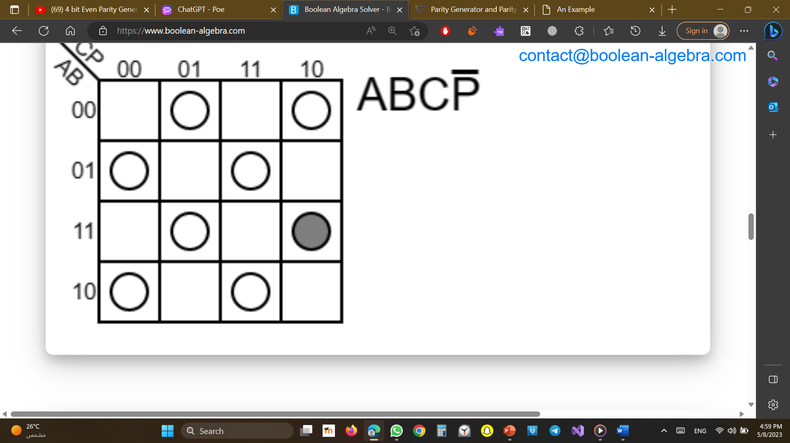
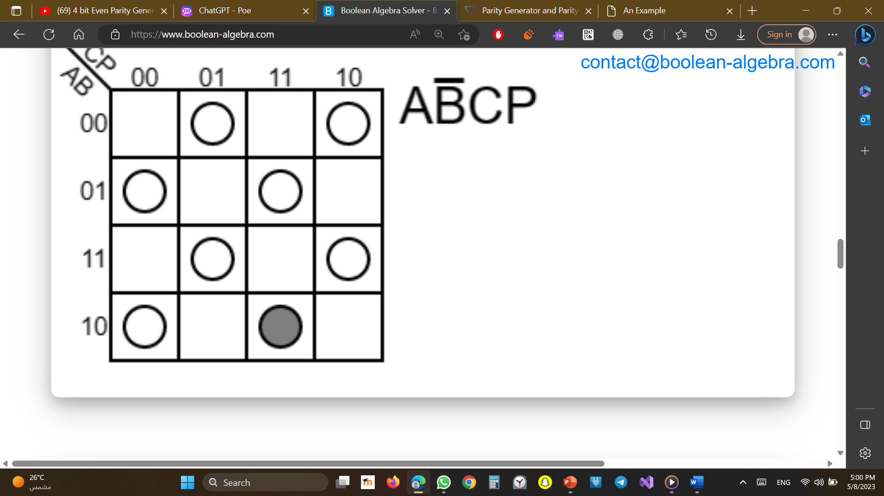

K-maps
0 1 3 2
4 5 7 6
12 13 15 14
8 9 11 10

Slide 5
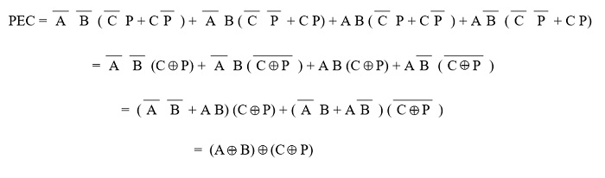
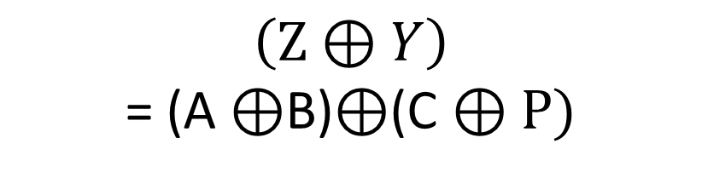
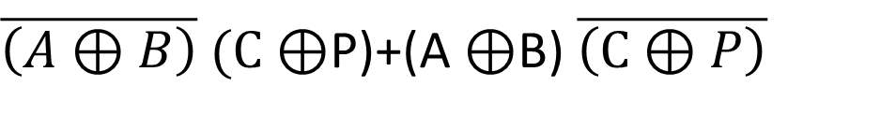
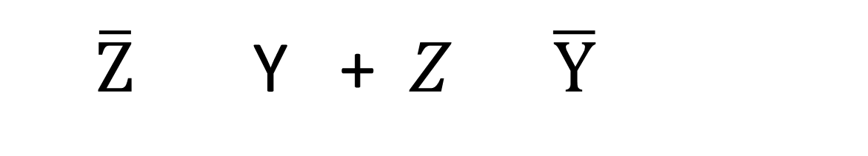
Boolean algebra
$\overline{A}\overline{B}\overline{C}P+\overline{A}\overline{B}C\overline{P}+\overline{A}B\overline{C}\overline{P}+\overline{A}BCP+AB\overline{C}P+ABC\overline{P}+A\overline{B}\overline{C}\overline{P}$+$A\overline{B}CP$
$\overline{\left(A⊕B\right)} (C⊕$P)+(A $⊕$B) $\overline{\left(C⊕P\right)}$
$\overline{Z}$ Y +$Z \overline{Y}$
Let:
$$\left(Z⊕Y\right)$$
= (A $⊕$B)$⊕$(C $⊕P)$
By substitute we will get

Slide 6
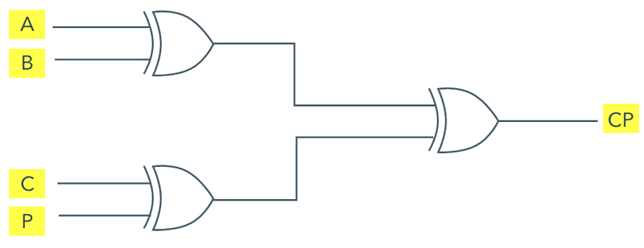
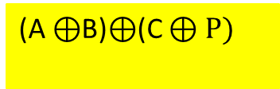
Logic circuit
(A $⊕$B)$⊕$(C $⊕P)$

Slide 7
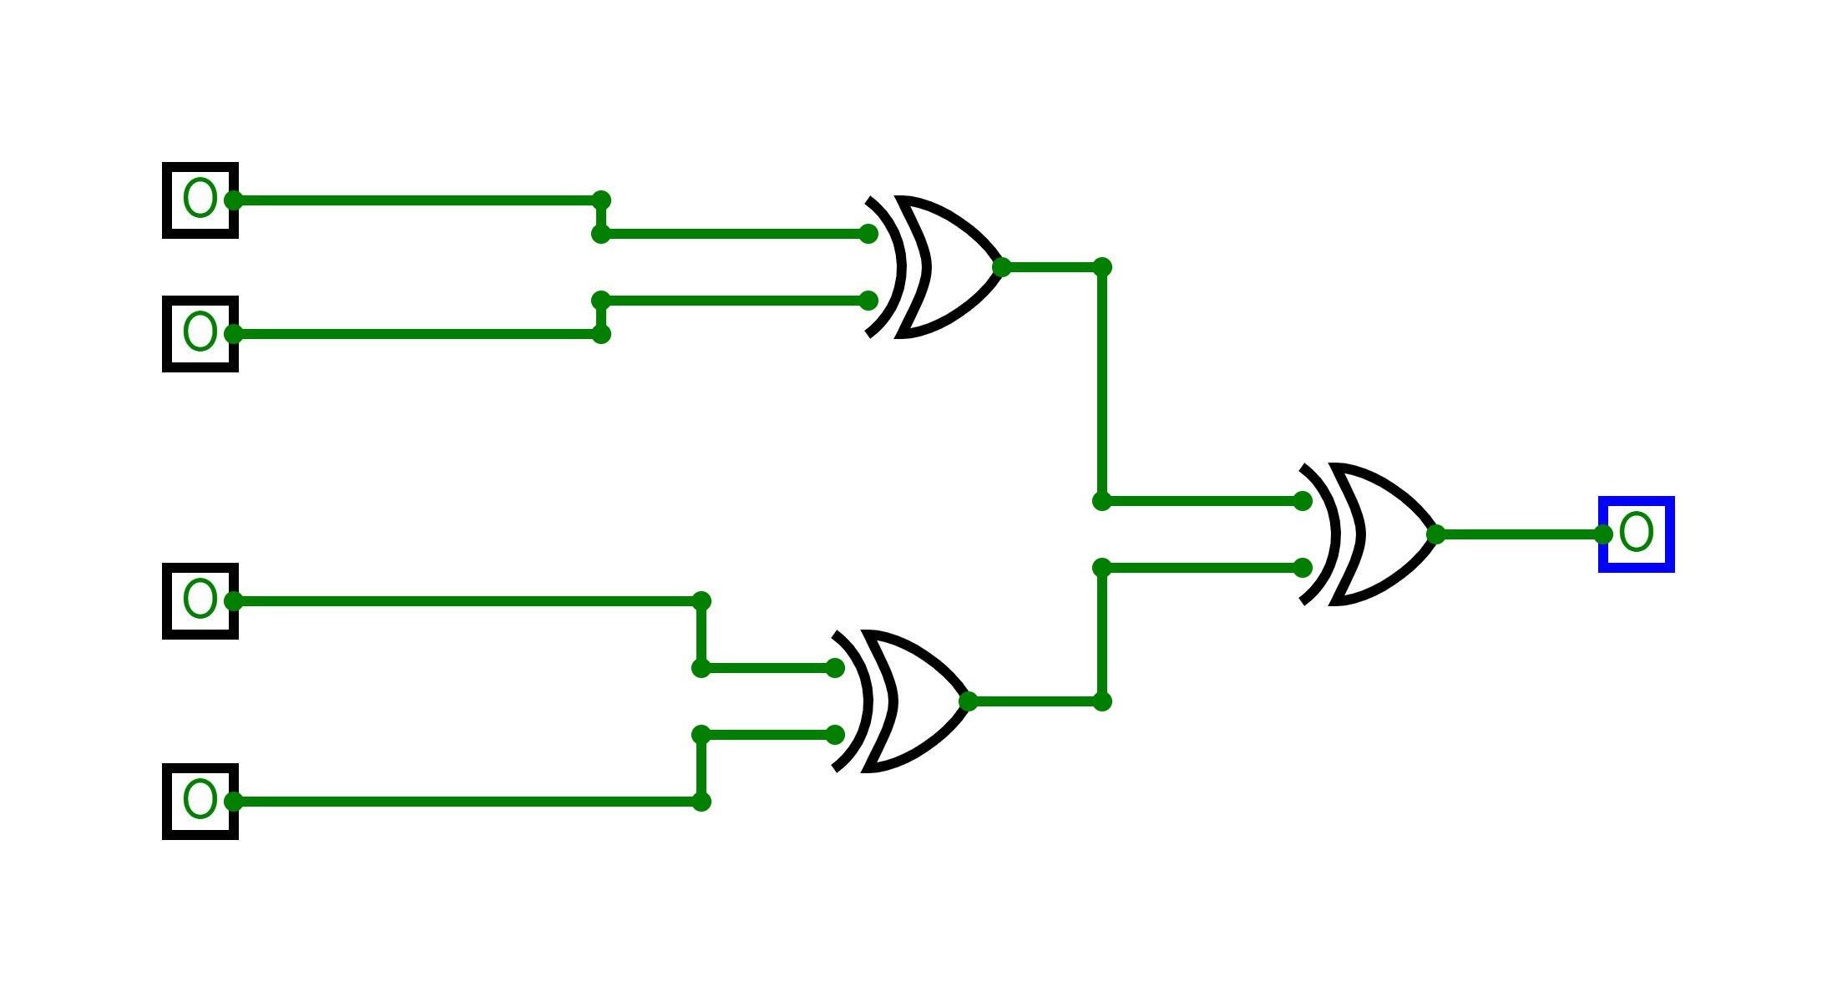
Stimulator

Slide 8
Thank you

